Slide 1






Sponsored & Brought to you by
The NOS-addin – your (free) BizTalk Dev buddy!
Sandro Pereira
http://www.twitter.com/Sandro_asp
https://pt.linkedin.com/in/sandropereira

Slide 2

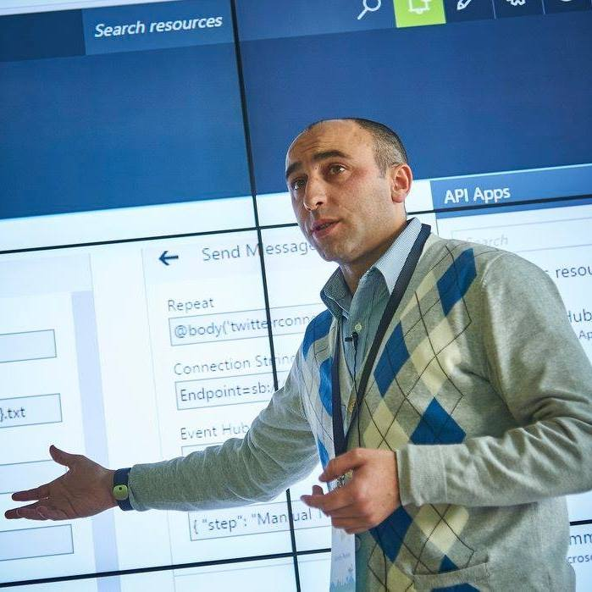


Who am I?
Integration Codeless Wizard
Microsoft Azure MVP
sandro.pereira@devscope.net
linkedin.com/in/sandropereira
@sandro_asp
https://blog.sandro-pereira.com/
Public speaker
Father
Book author: “BizTalk Mapping Patterns and Best Practices”
Sandro Pereira
+351 223 751 350
www.devscope.net
Notes:
Interested in all things integration – which of course includes MS Flow

Slide 3


What it is?

Slide 4

What is trying to solve?

Slide 5

LESS
It’s time to go beyond words!
MORE

Slide 6
…available for:
BizTalk Server 2016 - Visual Studio 2015
BizTalk Server 2013 R2 - Visual Studio 2013
BizTalk Server 2013- Visual Studio 2012

Slide 7
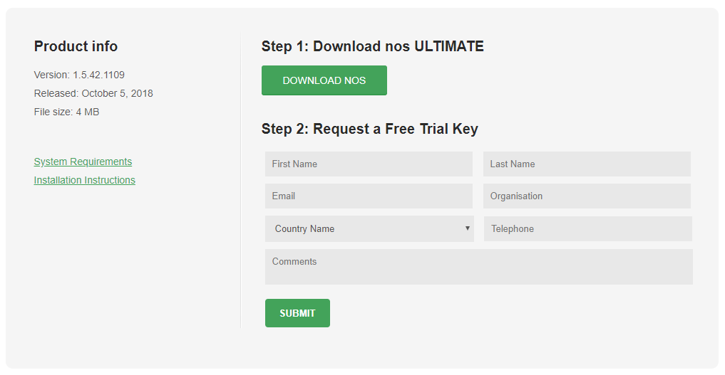
https://www.biztalk360.com/nos/free-trial.html

Slide 8

… but guess what? It is now free!

Slide 9





Thanks!
Sandro Pereira
Integration Codeless Wizard | Microsoft Azure & Visio MVP
sandro.pereira@devscope.net
linkedin.com/in/sandropereira
@sandro_asp
https://blog.sandro-pereira.com/
+351 223 751 350
www.devscope.net

